Slide 1
API Testing
By: Mahmoud Refat & Nada Abo Bakr

Slide 2
Agenda
Introduction to API
Types of APIs
Request/ Response
API Testing
API Challenges
API Tests examples
Overview of tools (Postman)
API Automation (Rest Assured)

Slide 3
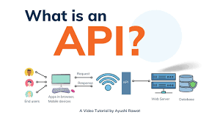
Introduction
API (Application Programming Interface) is a computing interface which enables communication and data exchange between two separate software systems.

Slide 4
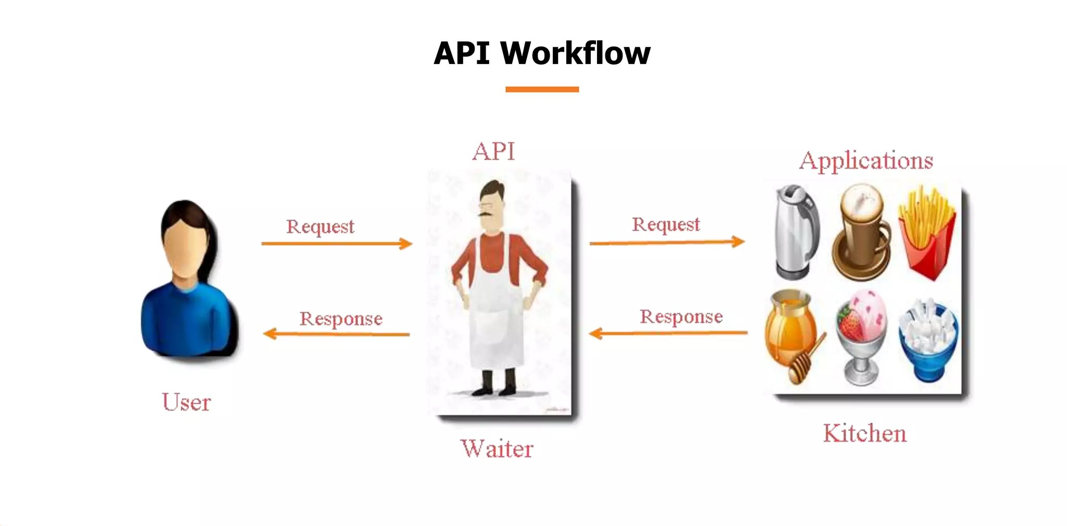

Slide 5
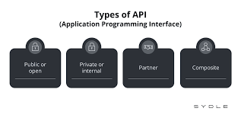
Types of APIs
Open APIs (public).
Partner APIs.
Internal APIs.
Composite APIs.

Slide 6
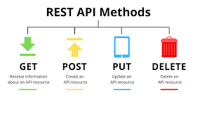
HTTP Methods
GET: Receive information about API resource.
POST: used to create a new resource.
PUT: used to update data for an existing resource.
DELETE: used to remove a resource.

Slide 7
Response Code and Message
Status code
200+ means the request has succeeded.
300+ means the request is redirected to another URL
400+ means an error that originates from the client has occurred
500+ means an error that originates from the server has occurred
Error Message
Some of the messages you’ve received like “Requires authentication” and “Problems parsing JSON” are error
messages. They only appear when something is wrong with your request. In case success message is success

Slide 8
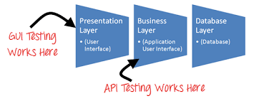
API Testing (Integration Testing)

Slide 9


API Testing Tools
Postman
Restassured
Java JDK
IntelliJ IDE
Maven should be provided as a built-in IntelliJ Plugin or installed as a stand alone tool
Basic Java knowledge
Framework assertion (ex. TestNG)

Slide 10


Project
Trello website.
Creating full request (post, get, put and delete).
Java Programming Language (POM Design Pattern).
Selecting Maven Project
TestNG as framework Assertion.

Slide 11
Thanks
By: Mahmoud Refat & Nada Abo Bakr

